Slide 1
Computational Graph

Slide 2

TPU
NPU
model
x = conv(x)
x = relu(x)
x = W2*x+b2
x = relu(x)
….
hardware-dependent blocks
basic functional blocks
matrix multiplication
action functions
transformation
…

Slide 3
f = (a+b*c)*3
Forward pass
2
a
+
v
3
b
14
*
f
u
*
12
3
42
4
c

Slide 4
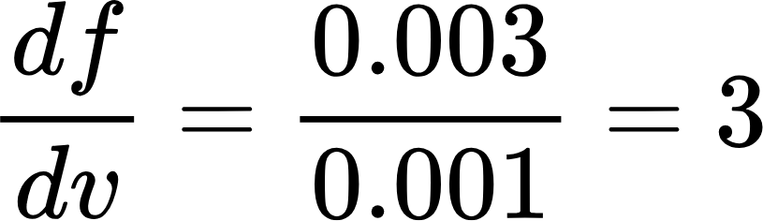
f = (a+bc)*3
Numerical Differentiation
2
a
14.001
+
v
3
b
14
*
f
u
*
12
3
42
4
c
42.003

Slide 5
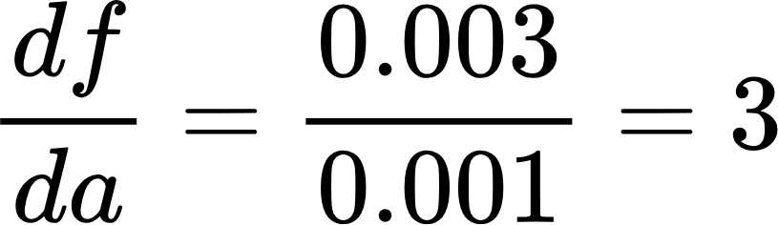
f = (a+bc)*3
2.001
2
a
14.001
+
v
3
b
14
*
f
u
*
12
3
42
4
c
42.003

Slide 6
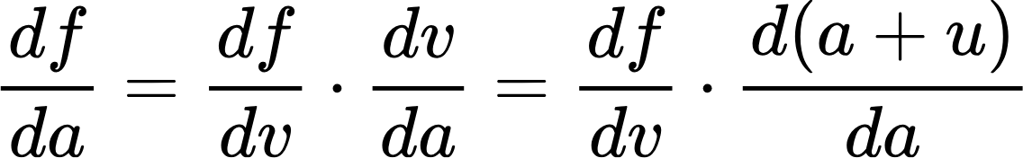
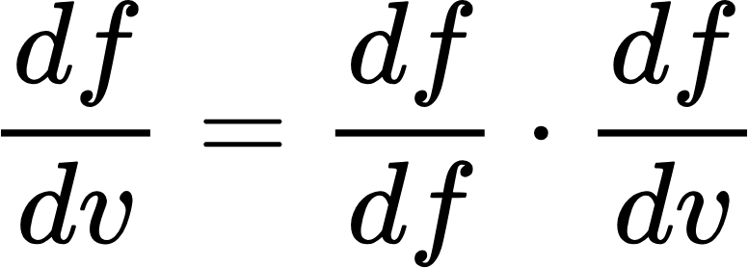
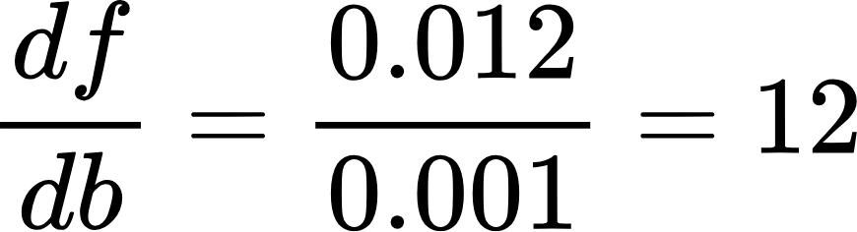
f = (a+bc)*3
2
a
14.004
+
v
3.001
12.004
3
b
14
*
f
u
*
12
3
42
4
c
42.012

Slide 7
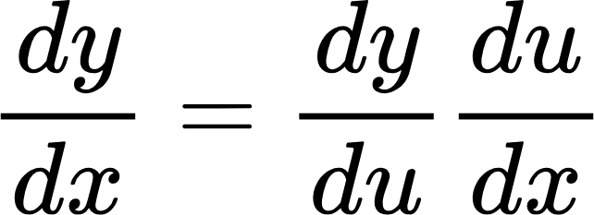
Chain rule
y = f(u) u = g(x) y=f(g(x))
x
g
u
f
y

Slide 8
f = (a+bc)*3
2
a
14.004
+
v
3.001
12.004
3
b
14
*
f
u
*
12
3
42
4
c
42.012

Slide 9
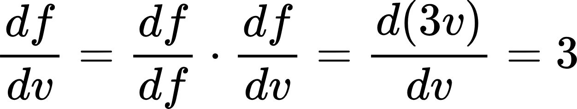
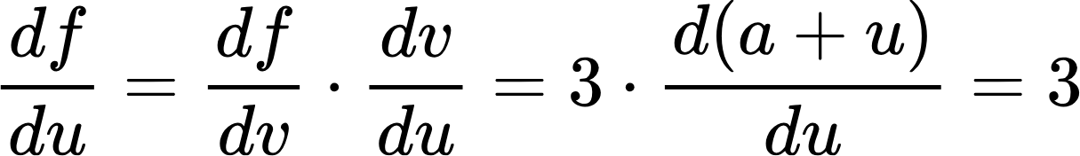
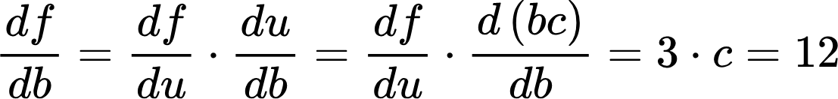
f = (a+bc)*3
Backward pass
2
a
14.004
+
v
3.001
12.004
3
b
14
*
f
u
*
12
3
42
4
c
42.012

Slide 10
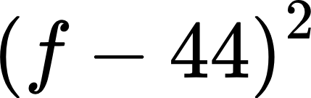
f = (a+bc)*3
loss function
2
a
14.004
+
v
3.001
12.004
3
b
14
*
f
u
*
12
3
42
4
c
w
42.012
l
We can not change the activations
3.9521
44
We can not change the input and ground truth

Slide 11
f = (a+bc)*3
loss function
forward pass
backward pass
parameter update
gradient descent
2
a
14.004
+
v
3.001
12.004
3
b
14
*
f
u
*
12
3
42
4
c
w
42.0139
l
3.001
3.897
44

Slide 12
The following session is optional

Slide 13
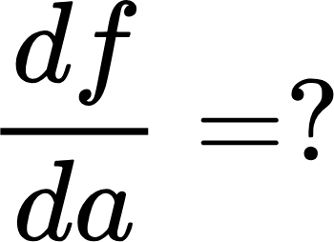
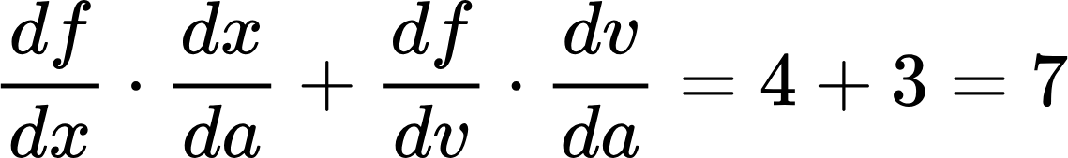
f = (a+bc)*3+a^2
With Branch
4.004001
^2
x
4
2
a
14.001
+
2.001
+
v
42.003
f
3
b
14
*
w
u
*
42
46
12
3
46.007001
4
c
46.003

Slide 14
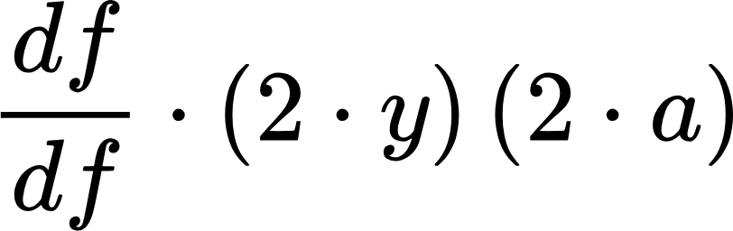
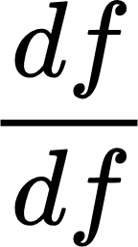
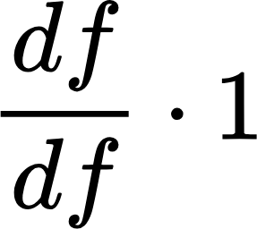
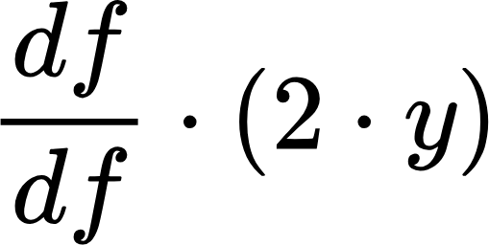
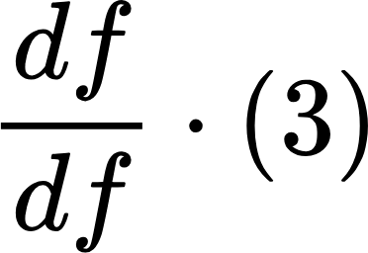
Order is important
^2
x
2
a
^2
y
+
+
v
f
3
b
*
w
u
*
3
4
c
This path is visited twice….. How should we deal with it?

Slide 15
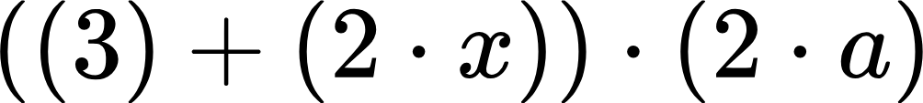
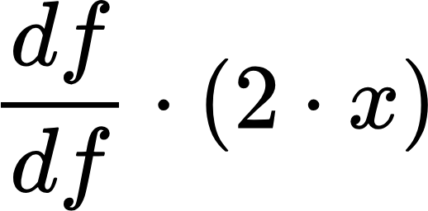
We should change the visit order
1
0
^2
x
2
a
^2
x
3
1
+
+
v
2
f
3
b
*
w
0
u
*
3
4
c
What’s the generation number?

Slide 16
Algorithm to deicde the order
function’s generation plus 1
max generation of all inputs
???
1
2
^2
x
0
0
1
a
^2
x
3
1
2
+
0
+
v
4
2
3
1
f
b
*
w
0
u
0
*
0
3
c
b.__mul__(c).__add__(a.__pow__(2)).__mul__(Variable(3)).__add__(a.__pow__(2).__pow(2))
f=(b*c+a**2)*3+(a**2)**2
The generation is decided in the forward pass.

Slide 17
variable and function

Slide 18
How to construct computational graph from python code?
function
a = torch.tensor([1.0, 2.0, 3.0])
b = torch.tensor([0.1, 0.2, 0.3])
c = a + b
a
+
c
b
operator override
variable
both a and b are python object. Why can we add them together?
a.__add__(b)
https://colab.research.google.com/drive/13SnAjuIAD3EtANQd5O7Hw86PYBgcMO3h#scrollTo=zoxSgmfc7KyB
https://koki0702.github.io/dezero-book/en/index.html

Slide 19
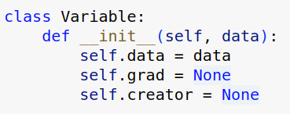
variable and function
a = Variable(1)
F= Function()
y = F(a)
Function
a
y
inputs
outputs

Slide 20
python operator override functions
a+b
a.__add__(b)
a*b
a.__mul__(b)

Slide 21
expression
a.__add__(tmp)
y = a+b*c
b.__mul__(c) —> tmp
a=Variable(1)
b=Variable(2)
c=Variable(3)
y = a.__add__(b.__mul__(c))

Slide 22
Where is the graph of a+b*c?
class Function:
def __call__(self, inputs):
x =[v.data for v in inputs]
v = self.forward(*x)
output=Variable(v)
output.set_creator(self)
self.input = inputs
self.output = output
return output
y = a.__add__(b.__mul__(c))
def add(self,x1):
return Add()([self,x1])
Variable.__add__=add
a
Add()
y
input
output
b
Mul()
def mul(self,x1):
return Mul()([self,x1])
Variable.__mul__=mul
input
output
c
class Mul(Function): def forward(self,i1,i2): return i1*i2

Slide 23
How can we construct a NN computation graph of model?
def model():
return a+b*c
def model():
return a+f()
def f():
return b*c
def model(arr):
f = arr[0]
for i in range(10):
if arr[i] >0:
f = f + arr[i]
return f
def model(arr):
f = arr[0]
for i in range(10):
if i % 2 == 0:
f = f + arr[i]
return f
def model(arr):
f = arr[0]
for i in range(10):
f = f + arr[i]
return f

Slide 24
Summary
The neural network itself will be defined by python expression.
We can use python function as part of in the expression.
It must return pure either numerical values or Variables.
The final result will be a computational graph defined by Functions and Variables.
We will use this graph to do
inference by using forward pass
calculate gradients by using the backward pass

Slide 25
step1-10: https://koki0702.github.io/dezero-book/en/index.html
step11-20 Write deep learning program in pure python
https://colab.research.google.com/drive/1siLVMOQSxBDCBj5Xf663aXnCdGqlzW4t?usp=sharing#scrollTo=zjo71k2XDxkh

Slide 26
A = Square()
B = Exp()
C = Square()
x=Variable(0.5)
a=A(x)
b=B(a)
y=C(b)
y.grad=1
y.backward()
0.5
0.25
1.28
1.64
X
A
a
B
b
C
y
3.29
2*0.5*3.29
3.29
exp(0.25)*2.56
2.56
2*1.28*1
1
This will be in the mid term!!!

